Slide 1
Maximizing Return on Big Mountain Ticket Price
Problem: $1.52M in new yearly expenses for chairlift needs to be offset in the budget
Revisiting our ticket price may allow us to leverage this to achieve this goal
Solution: The value of our facilities support an increased ticket price from $81.00 to $89.00-$90.00
Projected revenue increase of $15M annually
Estimated cost of $1.5M for chairlift installation, yielding a potential annual income of $13.5M
James Buckel

Slide 2
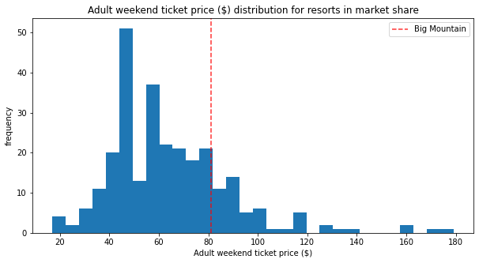
Recommendations and Key Findings
Increase ticket price from $81.00 to $89.00-$90.00
Modeled Big Mountain ticket price of $96.00
Conservative increase - accounts for unreliable or incomplete data
Projected revenue increase of $15M annually
Installation of new lift projected to increase revenue
Estimated lift installation cost of $1.5M
Estimated lift ticket price support of $8.61 with estimated annual profit of $15M
Closure of one run is possible without losing ticket price support
Best candidate is longest or most expensive run to maintain

Slide 3
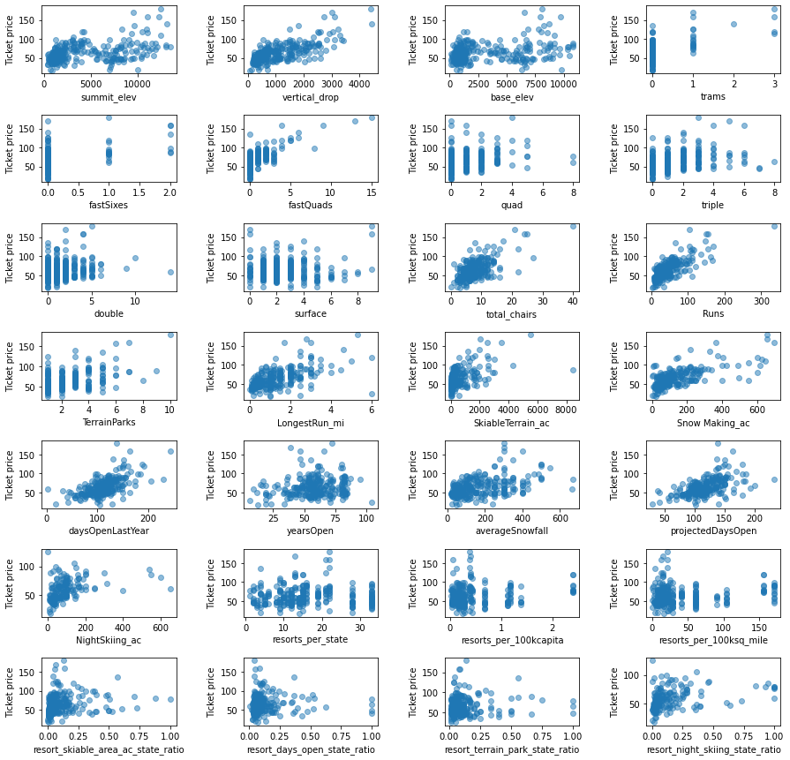
Modeling Results/Analysis
All viable variables in the dataset analysed for correlation with ticket price support
Cost of amenity factored into annual income gain

Slide 4
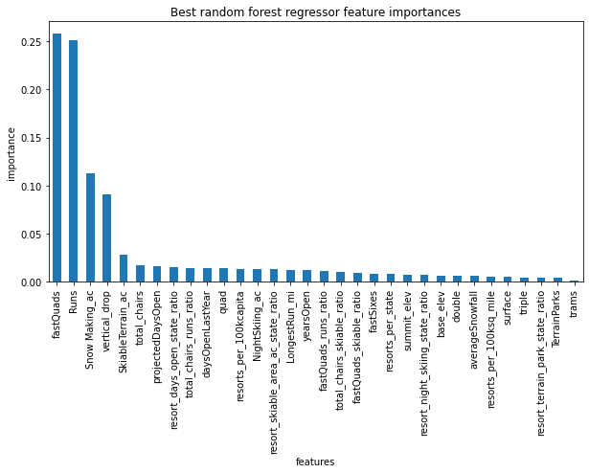
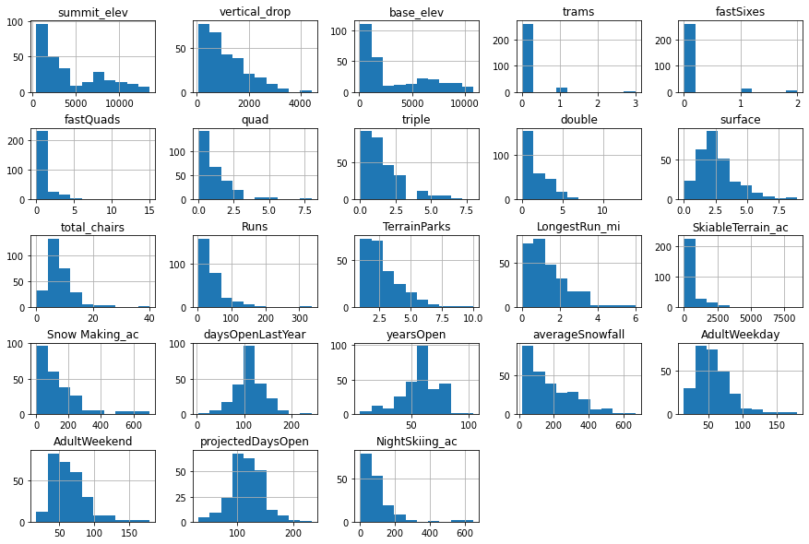
Modeling Results/Analysis
Most valuable changes to improve highest ticket price:
Adding a fast quad, runs, snow-making coverage, highest vertical drop

Slide 5
Modeling Results/Analysis
Most viable and cost-effective additions to support ticket price:
Increasing number of runs that are not long
Increasing number of quads
Increasing vertical drop

Slide 6
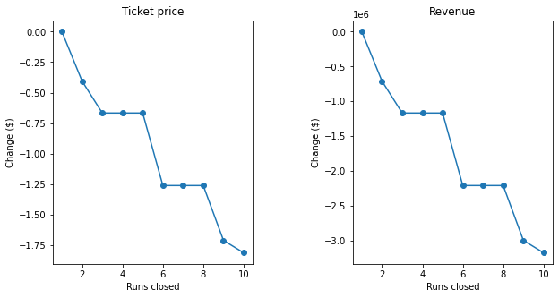
Modeling Results/Analysis
Closing zero, one, or five runs limits our loss of ticket price support per closed run to a minimum

Slide 7
Summary
At baseline, ticket price increase of at least $4 to $85 is supported
Modeled ticket price of $95.87
This increase accounts for average error of $10.39
Reduces likelihood of selling fewer annual tickets than more aggressive price increase
New lift and increased vertical drop is a lucrative investment
Further increases ticket price support by $8 to a final price of $93
Vertical drop added must be at least 150 feet
Closing the most expensive run reflects no meaningful loss in ticket price support
Can improve operating margins

